Slide 2
Career Readiness lesson
Resumes
Notes:
Title slide
Workplace skills lesson

Slide 3
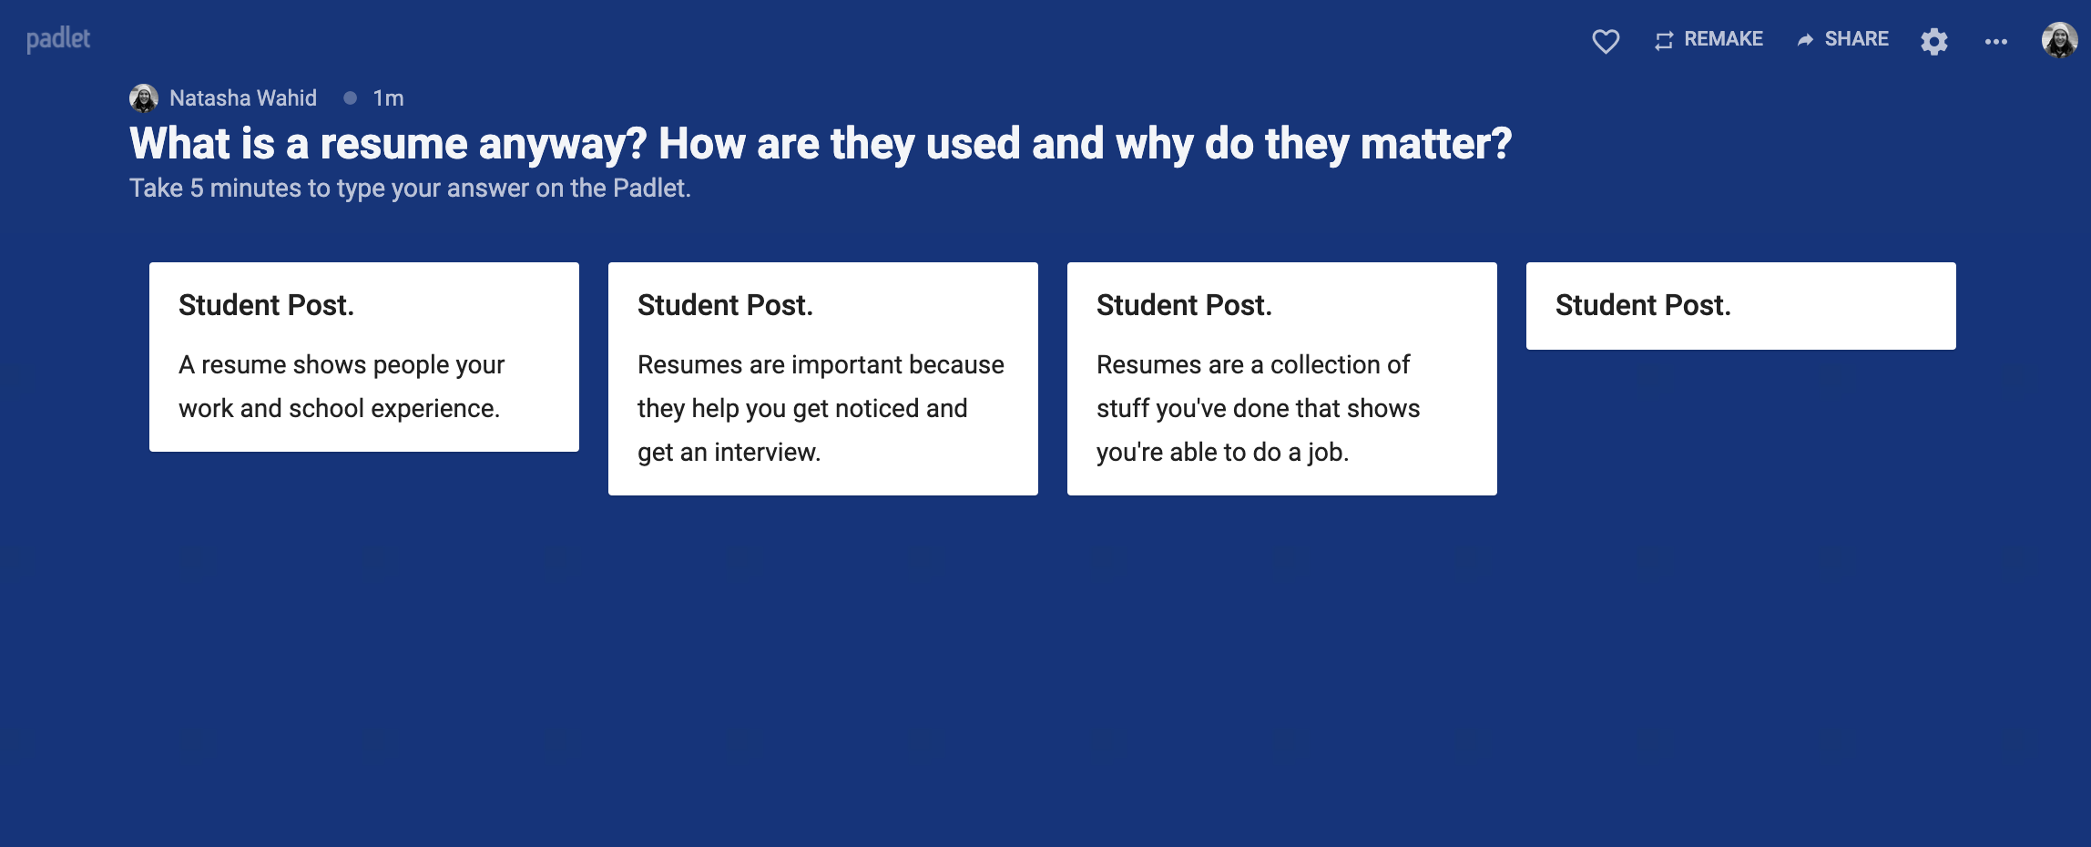

Do now
What is a resume anyway? How are they used and why do they matter?
Take five minutes to think and write. Then, post in the Padlet.

Slide 4
Debrief
Have you thought much about resumes before?
What experience do you have with resume-writing?
A resume helps potential employers understand who you are when you’re applying for a job. It won’t get you the job, but it can get you an interview.

Slide 5
What do we need to do to write a great resume?
1.
Reflect on our own experiences, strengths, and accomplishments.
2.
Get to know
our audience.
3.
Develop the content
for our resume.
4.
Practice building
a great resume.

Slide 6
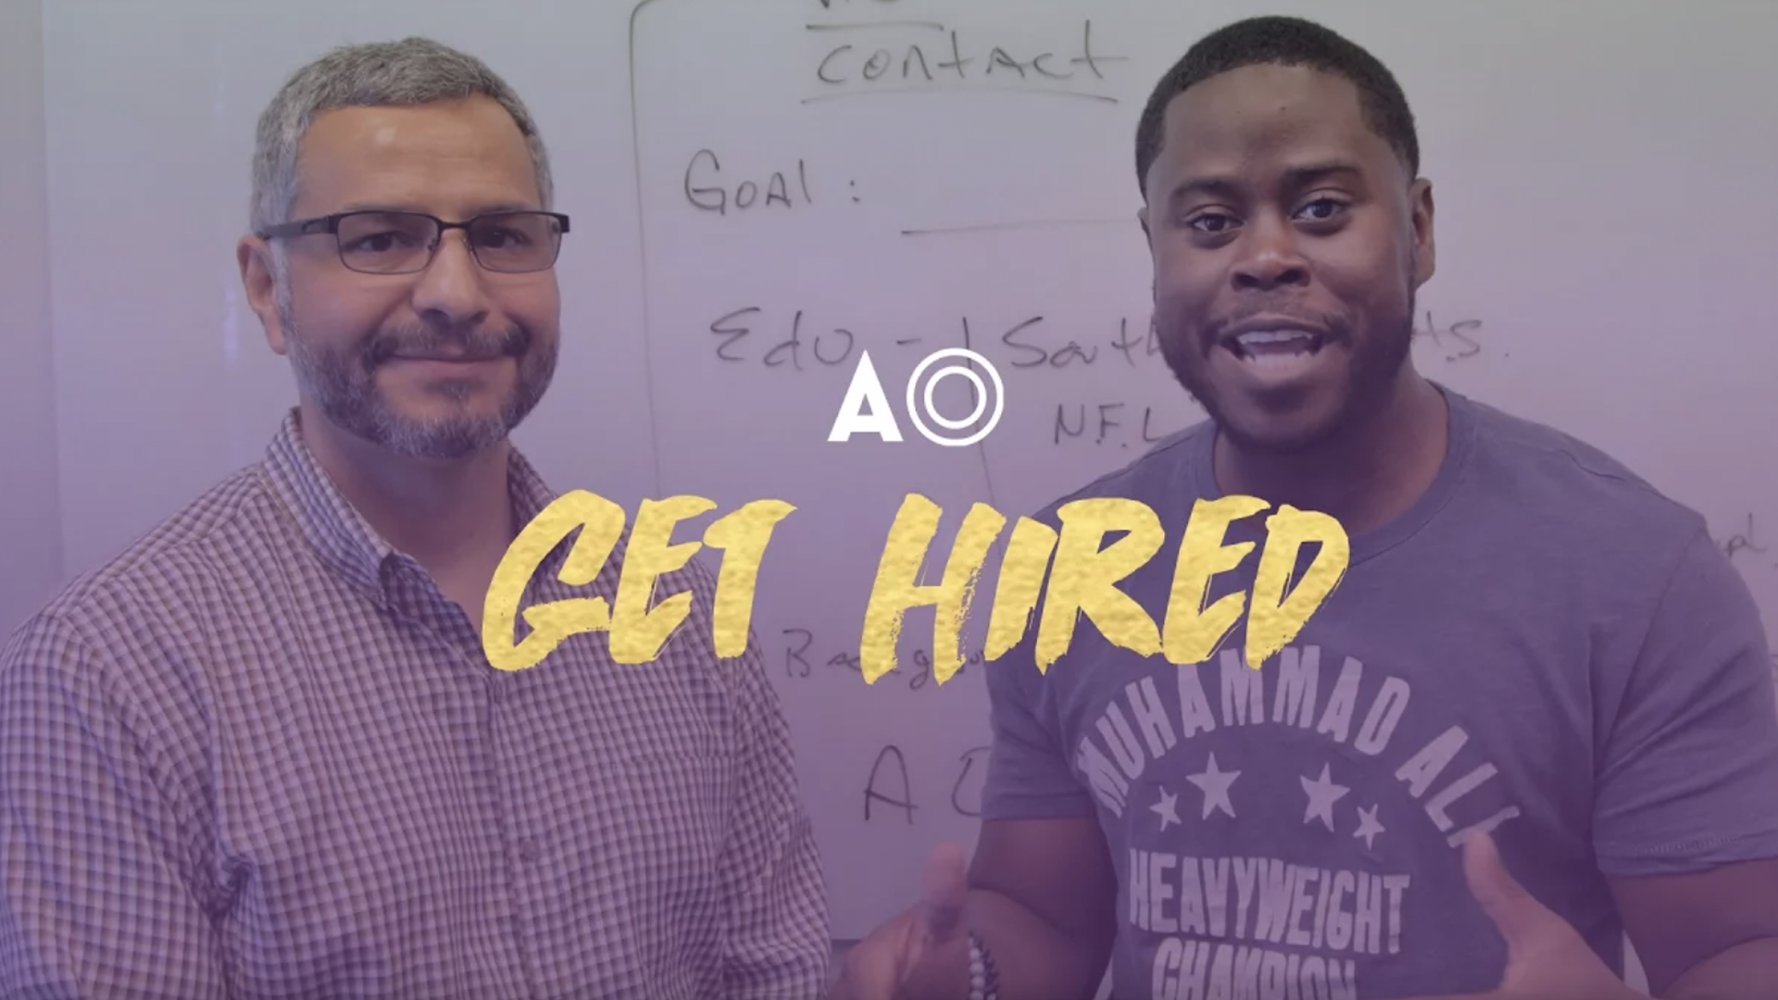
Why does your resume matter?
Recruiters spend an average of about six seconds reviewing a resume before making a decision! Your resume needs to make a great first impression, fast.
How can you write a resume that will help you get in the door, especially if you don’t have much experience? How do you get started?
Watch the video clip.
Notes:
Building a Great Resume
A strong resume is easy on the eyes.
You’ve nailed your content, and organized it like a pro. Now make sure your reader can scan it with ease.
Keep it to one page
Balance your text with white space
Use a professional, readable font
Check out examples and templates online for design inspiration

Slide 7
Understand Your Audience
A resume isn’t static, it’s dynamic! Your resume needs to flex with you and for you.
To do that well, you need to figure out what the employer is looking for and how your experience makes you a great match.

Slide 8
Developing your content
The best way to show an employer what you can do for them is to tell them what you’ve already accomplished. And not just what you did, but also why it matters—the “what” and the “so what?”
Accomplishment Statement = What + So What?
What = The task you accomplished
or were responsible for
So What? = The result or
impact of your actions,
or the rationale behind
what you did
Continue watching
the video clip.
Notes:
Building a Great Resume
A strong resume is easy on the eyes.
You’ve nailed your content, and organized it like a pro. Now make sure your reader can scan it with ease.
Keep it to one page
Balance your text with white space
Use a professional, readable font
Check out examples and templates online for design inspiration

Slide 9
Accomplishment statement examples
Peer Math Tutor
“Helped fellow high school students understand and apply key math concepts and prepare for their exams. Succeeded in helping my tutees raise their math grades by an average of 20%.”
Assistant Childcare Supervisor
“Established a safe, enjoyable, and enriching environment for children aged 5-12 by designing, preparing, and leading a variety of indoor and outdoor activities, while following appropriate safety protocols.”
Blood Center Volunteer
“Designed a PowerPoint presentation and a poster summarizing how and why to participate in the local blood drive, to raise awareness about the importance of blood donation in our community.”

Slide 10
Building a great resume
A strong resume is great content, well organized.
Three popular ways to organize resume content are:
Reverse Chronological: the most common format, emphasizes your most recent work experience
Functional: highlights your relevant job skills, regardless of where and
how you gained them
Combination: a hybrid of the other two formats, leads with core skills and follows with detailed work experience
The best format for you depends on your goals and what you want the employer to notice about you. Increase your chances of getting an interview by choosing the format that frames your skills and experience best.
Take a deeper dive into resume formats here.
Notes:
Developing Your Content
The best way to show an employer what you can do for them is to tell them what you’ve already accomplished. And not just what you did, but also why it matters—the “what” and the “so what?”
Accomplishment Statement = What + So What?
What = The task you accomplished or were responsible for
So What? = The result or impact of your actions, or the rationale behind what you did
Watch the video clip

Slide 11
Building a great resume
A strong resume is easy on the eyes.
After you’ve figured out your content and organized it like a pro, you’ll want to make sure it’s super easy to scan. Here are a few tips:
Keep it to one page
Balance your text with white space
Use a professional, readable font
Check out examples and templates online for design inspiration
Browse the galleries here.
Notes:
Developing Your Content
The best way to show an employer what you can do for them is to tell them what you’ve already accomplished. And not just what you did, but also why it matters—the “what” and the “so what?”
Accomplishment Statement = What + So What?
What = The task you accomplished or were responsible for
So What? = The result or impact of your actions, or the rationale behind what you did
Watch the video clip

Slide 12
Wrap-up
Your resume is a critical part of your work search toolkit. But it’s not the only part and it can only get you as far as an interview in your pursuit of your next dream job.
Be sure to keep your resume relevant, adapting it as your goals change and as you gain experience.
Continue watching the video clip.
Notes:
Building a Great Resume
A strong resume is easy on the eyes.
You’ve nailed your content, and organized it like a pro. Now make sure your reader can scan it with ease.
Keep it to one page
Balance your text with white space
Use a professional, readable font
Check out examples and templates online for design inspiration

Slide 13
Self-assessment
How prepared do you feel to write and tailor resumes for potential employers?
What aspect of the resume-writing process do you feel most confident about?
What part of your resume do you want to work on next?
What do you need more help with?
Notes:
Accomplishment Statement Examples
Peer Math Tutor
“Helped fellow high school students understand and apply key math concepts, and prepare for their exams. Succeeded in helping my tutees raise their math grades by an average of 20%.”
Assistant Childcare Supervisor
“Established a safe, enjoyable, and enriching environment for children aged 5-12 by designing, preparing, and leading a variety of indoor and outdoor activities, while following appropriate safety protocols.”
Blood Center Volunteer
“Designed a PowerPoint presentation and a poster summarizing how and why to participate in the local blood drive, to raise awareness about the importance of blood donation in our community.”

