Slide 2
Career readiness lesson
Interviewing

Slide 3

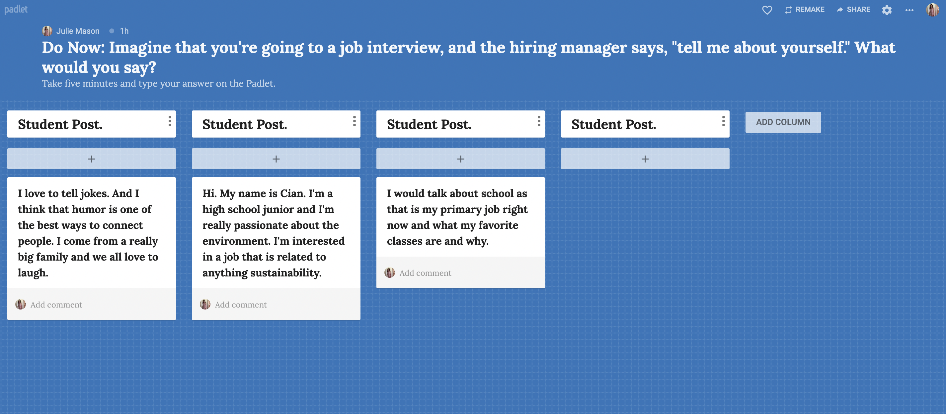

Do now
Imagine that you’re going to an interview. The hiring manager says, tell me about yourself. How do you answer?
Take five minutes to think and write. Then, post in the Padlet.

Slide 4
Debrief
Was this question hard to answer?
Why or why not?
Did you feel prepared to answer?

Slide 5
What do we need to do to prepare for an interview?
1.
Get to know ourselves and practice answering common interview questions.
2.
Learn best practices
for interview preparation.
3.
Write and practice giving our elevator pitch.
4.
Practice answering interviewing questions and give and get feed-back from our peers.

Slide 6
How to answer,
“tell me about yourself?”
Watch the video.
What are some suggestions for how to answer this question?
What should you avoid?

Slide 7
Best practices for answering, “tell me about yourself?”
“Tell me about yourself” is probably the most commonly asked question in interviews. How you answer this question greatly affects the first impression you give, and it sets the tone for the entire interview.
Share your education so far and any work experience you have. (It’s great to mention awards, grades, challenges, and obstacles you’ve overcome.)
Tailor your answer to the job description.
Use chronological order.
Keep it professional.

Slide 8
Common interview questions
Why do you want this job?
What would your teachers say about you?
Why should we hire you?
Where do you see yourself in five years?
Before we can answer these questions, we need to get to know ourselves better. One of the best ways to do this is to tell stories, write, and get curious
about ourselves.

Slide 9
Who do you think you are?
What are your strengths? What are
your challenges?
What are your goals? Your hopes? Your dreams?
What’s a problem that you’d really like to solve?
Tell a story about someone who had a significant impact on you.
What’s the hardest thing you’ve ever done?
What’s a mistake you made? What did you
learn from it?
Tell a story about a place that is important
to you.

Slide 10
Interview preparation checklist
Research the company.
Read the job description.
Prepare responses to common interview questions.
Practice your responses to these questions.
Plan your outfit.
Make sure you know how long it will take you to get to the company or if you are interviewing online, what information and tools you need to log in.

Slide 11
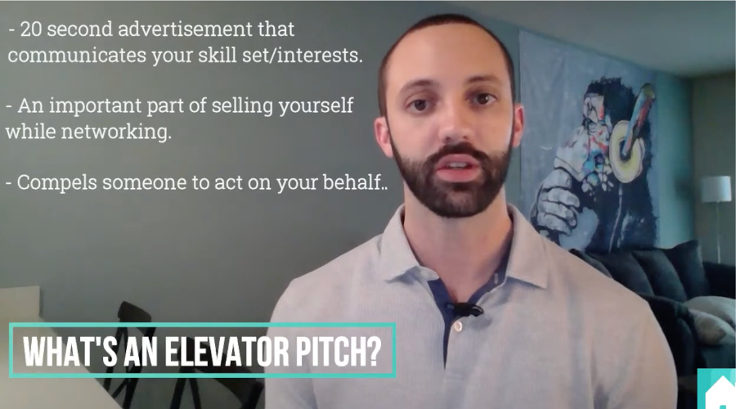
How to give an elevator pitch
Watch the video.
What’s an elevator pitch?
Who is the audience?
What’s the purpose?

Slide 12
Elevator pitch writing tips
01.
Keep it brief. Don’t tell your whole life story. Give a short recap of who you are and what you do.
02.
Be persuasive and positive. Like a strong thesis statement, you want to get the hiring manager’s attention. Focus on what you want to do—not what you don’t.
03.
Mention your goals. Get to the point and say what you’re looking for.
04.
Know your audience. Research the industry and company, notice the language they use when they talk about their work, and write your elevator pitch using that language.

Slide 13
Elevator pitch
delivery tips
Don’t speak too fast
Avoid filler words “like,” “um”
Deliver your pitch with energy and enthusiasm
Avoid a monotone delivery and use expression
Make eye contact

Slide 14
Interview peer-to-peer feedback
When you were in the outer circle what did you observe your classmates saying and/or doing when they gave a strong answer?
When you were in the inner circle answering questions, how did it feel? What questions were easier to answer than others?

Slide 15


Self-assessment
01.
What do you feel are your interviewing strengths?
02.
What do you want to work on before you are interviewed?
03.
What do you need more practice with?

