Slide 2
Career Readiness lesson
Career exploration and planning
Notes:
Title slide
Workplace skills lesson

Slide 3
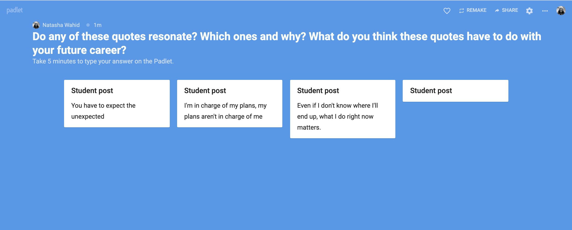

Warm-up
“Plans are worthless, but planning is essential.”
— Dwight D. Eisenhower
“Just because you made a good plan, doesn’t mean that’s what’s gonna happen.”
― Taylor Swift
“You don't have to see the whole staircase, just take the first step.”
― Martin Luther King Jr.
Do any of these quotations resonate with you? Which one(s) and why?
What do you think they have to do with your future career?
Take five minutes to think and write. Then, post in the Padlet.

Slide 4
Debrief
Do you have a career plan? What is it? Would discarding this plan hurt you—or help you?
Knowing where you want to go is important, but so is being ready to adapt to surprises.
Life can be turned upside down, and the world of work is changing all the time.

Slide 5
Are you making career decisions based on instrumental reasons or fundamental reasons?
Instrumental
rigid, fixed, outcome-dependent
action is a means to an end
relies on external stability and security
closed to unexpected opportunities
Fundamental
flexible, fluid, adaptable
action is inherently valuable, no matter where it leads
relies on your internal values
open to unexpected opportunities

Slide 6
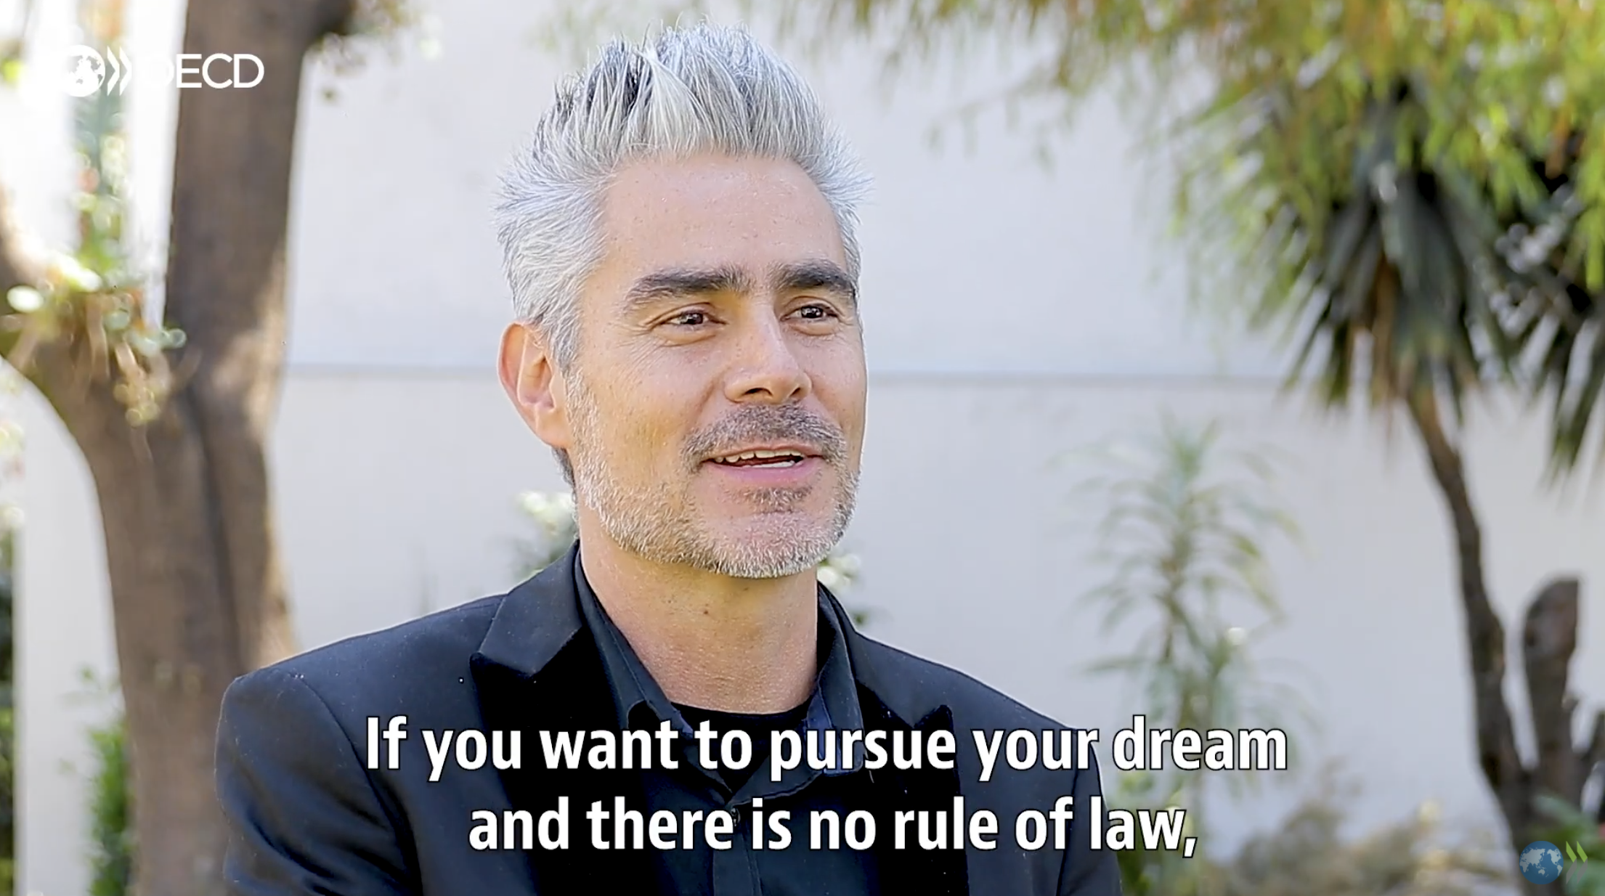
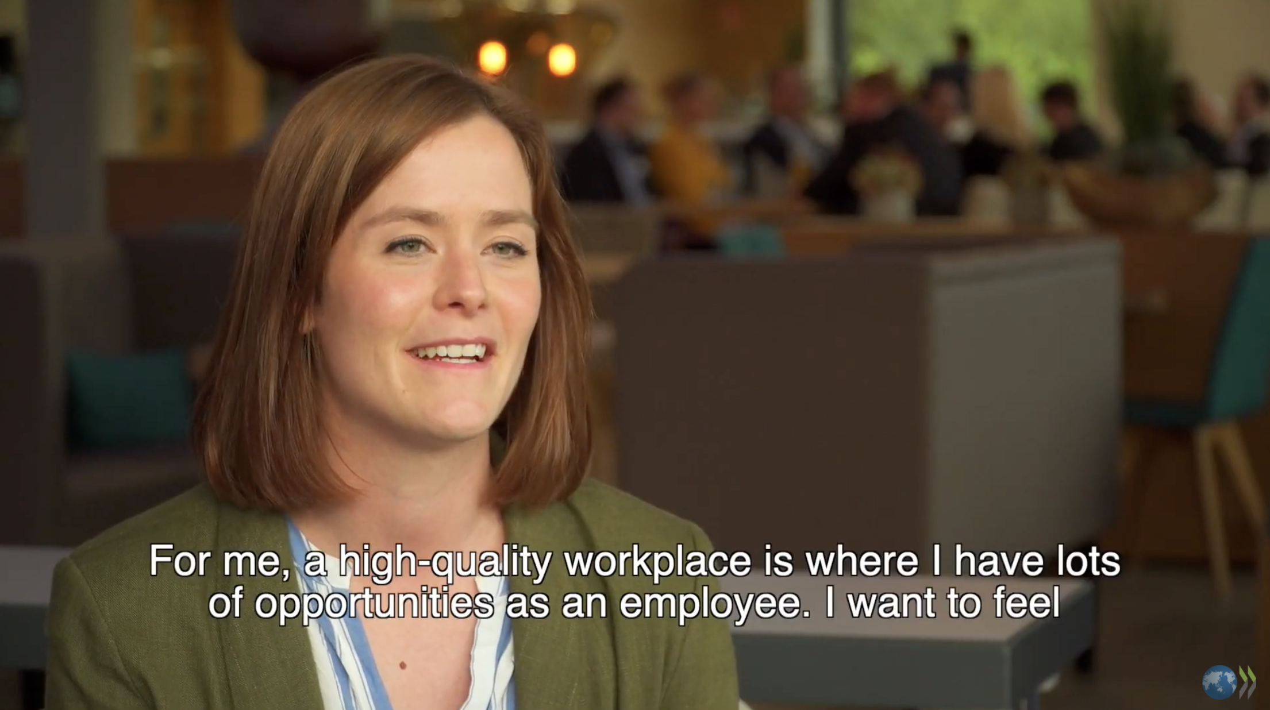
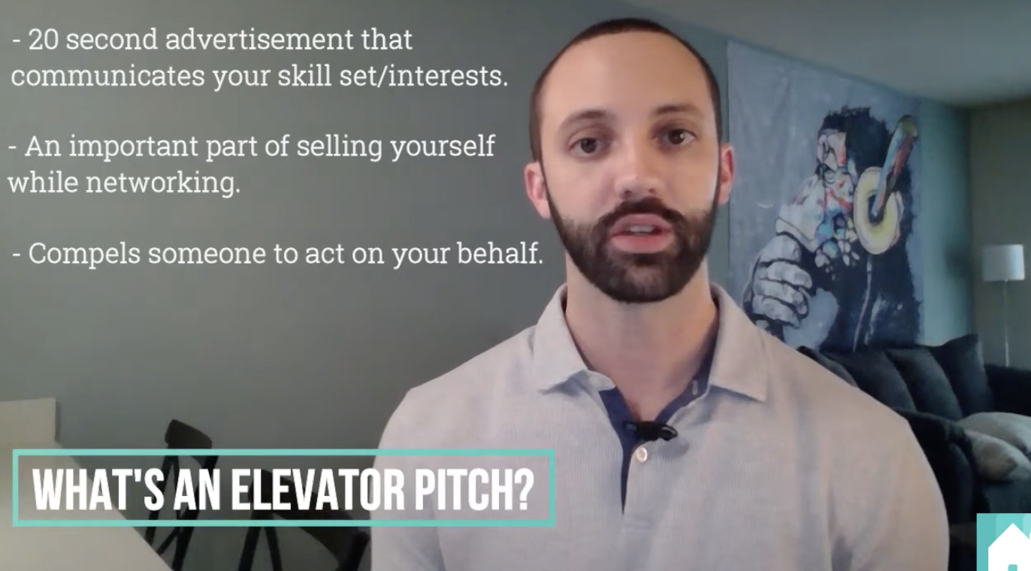
Why think about this now?
In an ever-changing and increasingly complex world of work, building a career is about continually discovering how you can apply your strengths, passions, and hard work in the world, to do something that matters.
Watch these video clips:
Daniel Gutiérrez on following your passion (1:51)
Finding the right job for you (2:45)
i
Notes:
Building a Great Resume
A strong resume is easy on the eyes.
You’ve nailed your content, and organized it like a pro. Now make sure your reader can scan it with ease.
Keep it to one page
Balance your text with white space
Use a professional, readable font
Check out examples and templates online for design inspiration

Slide 7
Tap into your WIFI
W
— Watch Your Interests
— Investigate Your Options
— Follow Your Dreams
— “I’m interested in _____ & I’ll see where it leads me.”
I
F
I

Slide 8
Tap into your WIFI
What interests you?
  List 5 ways you enjoy spending your time.
What are your skills?
  List 5 things you're good at.
How would your friends describe you?
  List 5 ways they'd explain what you're like.
If there was no chance you’d fail, what would you do? Anything at all!
  List 5 ideas that excite you.

Slide 9
Real people, real pathways
Exploring other people’s career journeys can help you shape your own.
Tell us about your person. What’s their current work role?
What was the path they took to their current role?
What do they like most about their job?
What is the most challenging aspect of their role?
If you were interested in a job like this one, what qualifications and experience would you need?

Slide 10
Real people, real pathways
Exploring other people’s career journeys can help you shape your own.
What did you find most interesting or surprising?
How has this changed the way you think about career pathways, in general?
How has this changed the way you think about your future career, in particular?

Slide 11
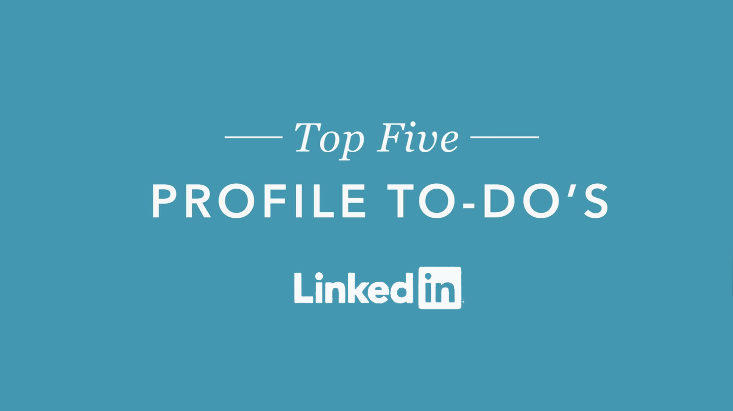
LinkedIn for students
Build a professional reputation online
Showcase your best work
Meet people working in fields that interest you
Find job opportunities
Watch the video clip
Notes:
Building a Great Resume
A strong resume is easy on the eyes.
You’ve nailed your content, and organized it like a pro. Now make sure your reader can scan it with ease.
Keep it to one page
Balance your text with white space
Use a professional, readable font
Check out examples and templates online for design inspiration

Slide 12
Cool down
How prepared do you feel to explore and plan your career future?
What’s your next best step?
What do you need more help with?
Notes:
Accomplishment Statement Examples
Peer Math Tutor
“Helped fellow high school students understand and apply key math concepts, and prepare for their exams. Succeeded in helping my tutees raise their math grades by an average of 20%.”
Assistant Childcare Supervisor
“Established a safe, enjoyable, and enriching environment for children aged 5-12 by designing, preparing, and leading a variety of indoor and outdoor activities, while following appropriate safety protocols.”
Blood Center Volunteer
“Designed a PowerPoint presentation and a poster summarizing how and why to participate in the local blood drive, to raise awareness about the importance of blood donation in our community.”

