Slide 1
Design Thinking Activity Directions
This powerpoint is a guide to teach an introductory design thinking lesson.
Each slide contains clear step-by-step directions in the notes section below the slide.
This is a template, please adjust and edit to meet your needs.
It can be tailored to meet the needs of any age group of experience level.

Slide 2
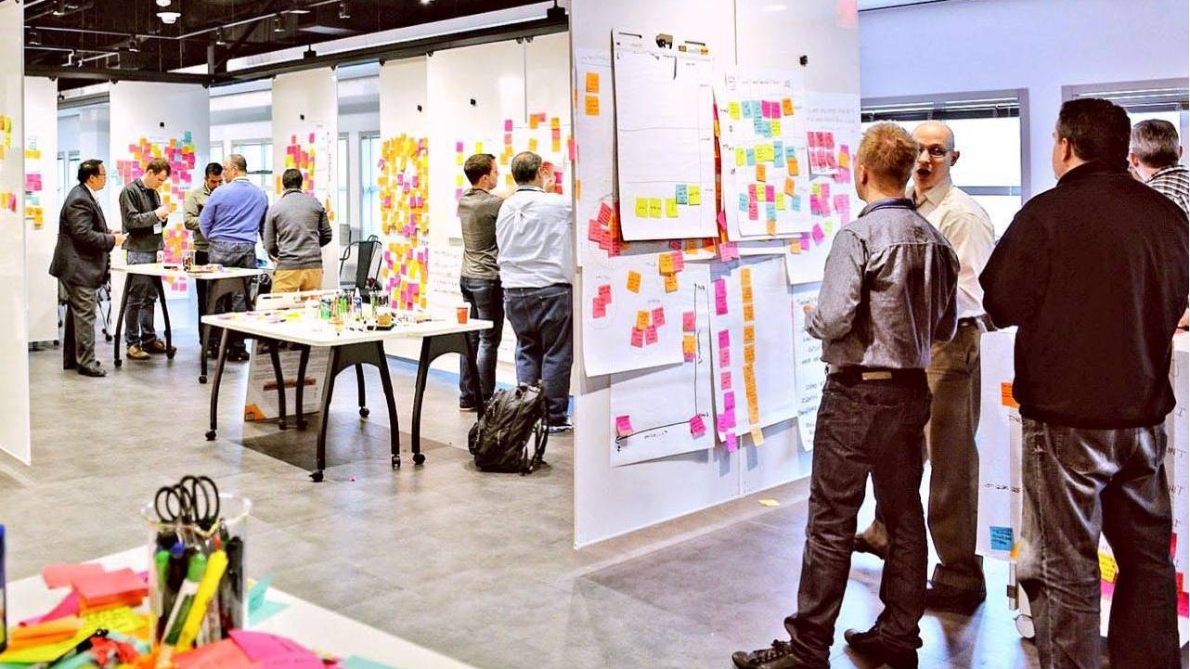
Design Thinking
IBM

Slide 3
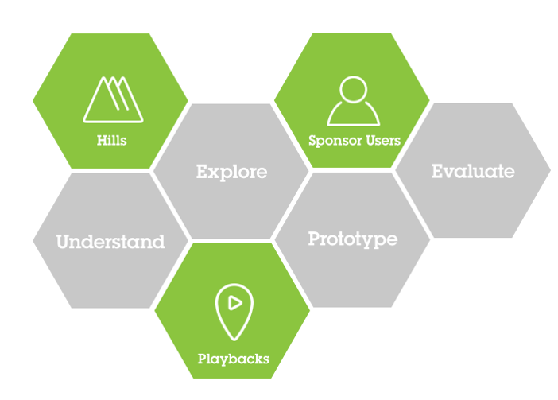
Introduction to Design Thinking
Clich HERE for video
(You must be in presentation mode for link to work)
Notes:
-Prompt students to watch the video above by them by asking them to think about what design thinking is in their own words while they watch.
-Watch video (5mins).

Slide 4
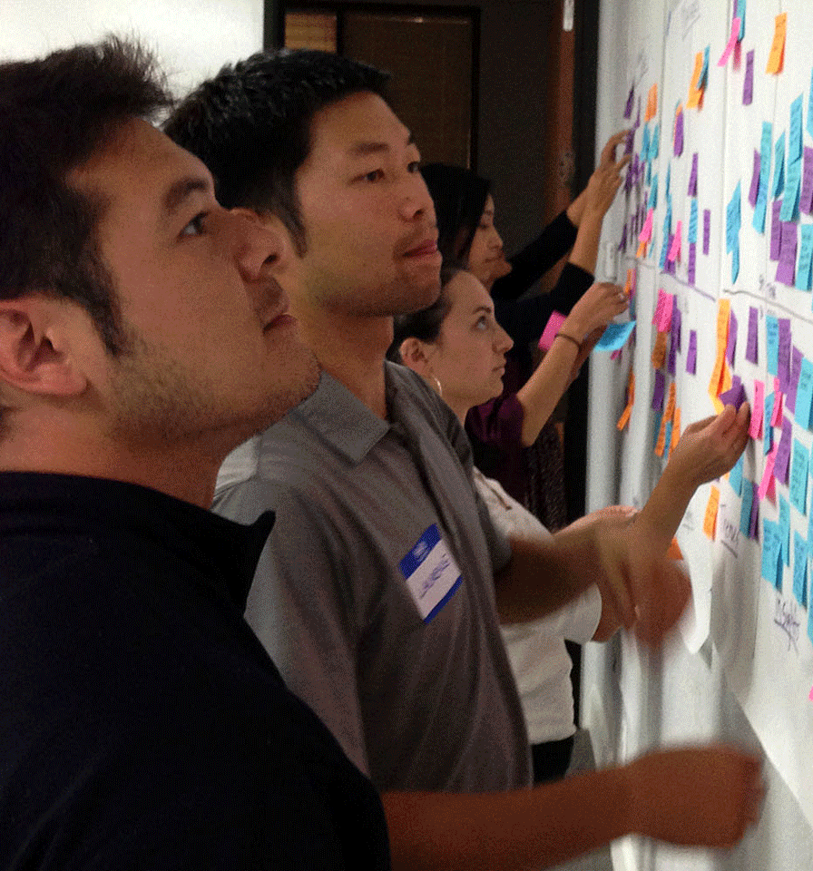
What is Design Thinking? in your own words
Notes:
-After video, instruct students turn and discuss their answer with a partner; tell them you will be cold calling for two answers (1min).
-Come back together as a group and cold call two students to share answer (1min).
-Summarize & connect answer/whole class discussion (2mins)

Slide 5
1st Step: Divide the class into groups of 4-5
Design Thinking Activity Set-Up
What each group needs?
1 Post-It Note easel pad (chart paper) with multiple sheets
Markers
Lots of Post-It notes
Notes:
Time 2 minutes

Slide 6
Understand the problem/issue you want to design a solution for
You can brainstorm multiple issues/problems as a class or in groups.
Example: Brainstorm problems your community that you want to solve.
Students may say things like…
Homelessness
Animals in shelters do not have homes
Community service opportunities
Elderly transportation
Students choose which problem they want to design a solution for.
Each group could work on a different problem or the whole class can work on the same problem.
Each group writes their problem down on a sticky note and keeps in a central location
Notes:
Brainstorm as a group or as a whole class. Topics could also be assigned to save time. Time for this is flexible based on your needs.

Slide 7
1st step of design is understanding the user’s emotions
Why is it important to understand the emotions of the people you are designing a product for?
Notes:
Ask the students why is it important to understand the perspectives of the people you are designing a product for?
Have them stop and write the answer on a sticky note, then have the students discuss with a partner and cold call 2 answers.
(3 minutes total)

Slide 8
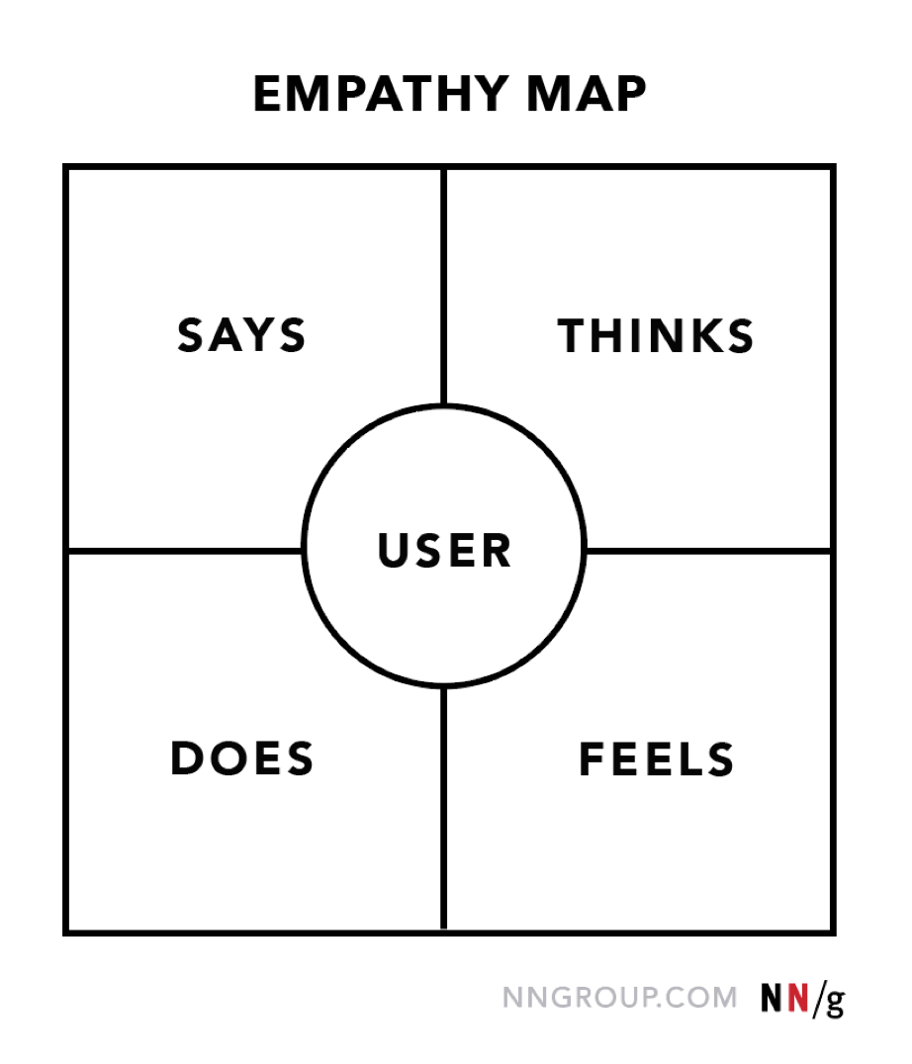
Empathy Map
Each group should sketch an empathy map on a new piece of chart paper with the quadrants – says, thinks, feels, does and a circle in the middle.
Empathy: the ability to understand and share the feelings of another
Notes:
(1 Minute)

Slide 9
2nd Step – Sketch Your User
Think about your problem. Who is your “user”? Who is the person you are designing a solution for?
Sketch your user in the center circle of the quadrants
Give them a name
Draw a picture of them
Provide some details of who they are (e.g., a parent who travels with children, a business person who travels for work weekly, etc.)
Notes:
Time 2 minutes

Slide 10
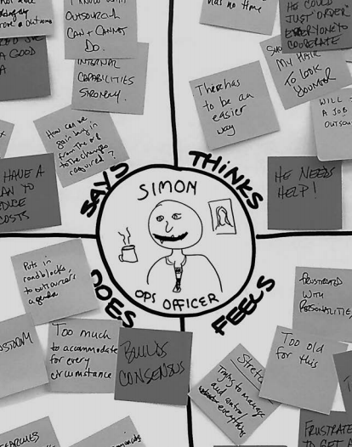
3rd Step - Ideating
Independently: begin brainstorming what/how the user says, thinks, feels, and does in relation to the problem
One idea per sticky note – keep it simple
Post sticky’s in each quadrant
Notes:
Time 4 minutes
Say to students
Based on the user you designed, develop one idea per post it note about what the user says, thinks, does, and feels
No idea is wrong at this point – be specific as possible
As you see the students slowing down in their brainstorming, encourage them to develop a few more ideas – no idea is wrong encourage them to be brave – fail often and fail fast

Slide 11
4th Step – Grouping Ideas
As a group, begin reading through the ideas on each quadrant and grouping the ideas together
I.e., common themes amongst what you and your peers included under each quadrant
Note - there will not always be “perfect” groupings, this is more about getting into each other’s thinking and identifying some common themes
Notes:
Time 4 minutes
Say to students:
You are going to group you post it notes based on themes in each quadrant
You should move the post it notes around to group them and make notes next to the groups identifying the “theme”
*It is important you walk around and circulate the room during this time to support students

Slide 12
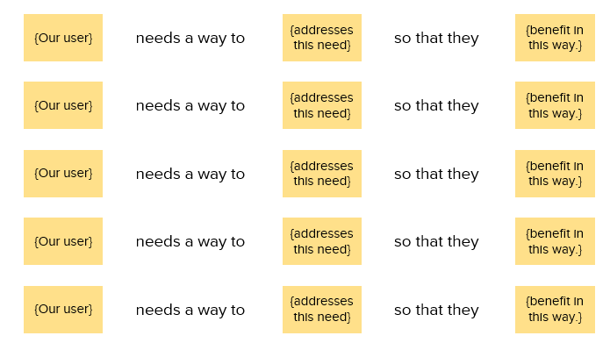
5th Step – Identifying Your User’s Needs
Based on your brainstorm & groupings, do the following on a new piece of chart paper as a group:
At the top of the paper write: [our user] needs a way to [addresses this need] so that they [benefit in this way]
You will place post-it’s below
Identify 3-4 “need” statements (E.g., Toni needs X, Y, Z, so that she can X, Y, Z)
Notes:
Time 7 minutes
Say to students:
You have 4 minutes as a group to develop 3-4 “needs” statements
Pause the students when the timer goes off
On their own, they need to brainstorm solutions for their user’s needs – 3 minutes
When you see students start to slow down with their ideas, push them to give a few more ideas. Remind them no idea is too big, silly, or “impossible/not right”. This exercise is all about thinking about the ”could be”

Slide 13
6th Step - Brainstorm Solutions
Independently, brainstorm possible solutions to your user’s needs – 1 idea per post it note. Place all notes on a new piece of chart paper
Quantity over quality
Come up with all types of solutions. Imagine there was no financial or material barriers.
Treasure Wild Ducks*
No idea is too big, silly, or “not right”
Be Brave
Notes:
Time 3 Minutes

Slide 14
^{7th} Step – Identifying 1 Solution that can be Implemented
As a team, review the need statements and solutions
Identify the most important need & solution (this will probably be a combination of multiple) that you would like to present to the user
Choose 1-2 people in your group to present your user, their need, and your recommended solution.
Notes:
Time 3 minutes

Slide 15
^{8th} Step – Presenting the solution
Each group will…
1 minute presentation from each group
1 minute from audience to ask questions/provide constructive or positive feedback
Notes:
2 minutes per group

Slide 16
Discussion
Have a discussion about the design thinking process.
Ask students to talk about their experience as a group or as a whole class.
What was really cool about design thinking?
How did it change the way they solved a problem?
How else can this process be used?
Notes:
Time 5 minutes

Slide 17
CLOSEOUT
Thank you students for being learners and leaders.

